Slide 1
A short survey about whether you read instructions
Survey Results Report
20 people have responded
September 25, 2026 – September 25, 2026

Slide 2
Survey Overview
Total Responses
20
Published
September 25, 2026
First Response
September 25, 2026
Last Response
September 25, 2026

Slide 3
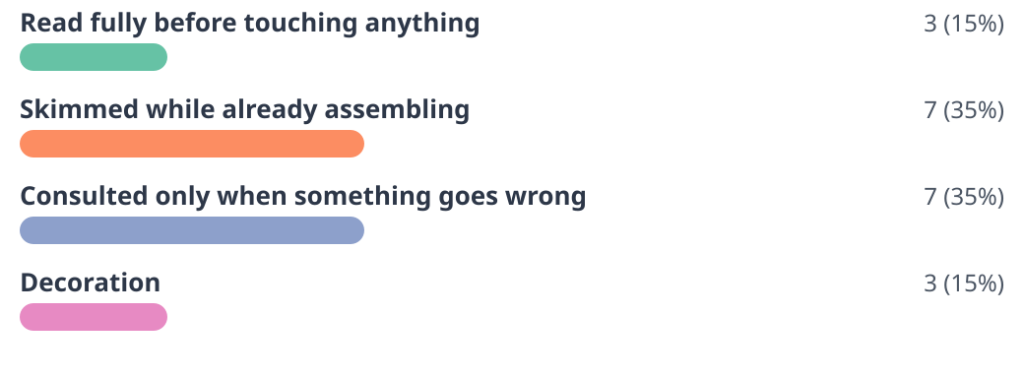
#1
A new gadget arrives. The instructions are:
20 responses

Slide 4
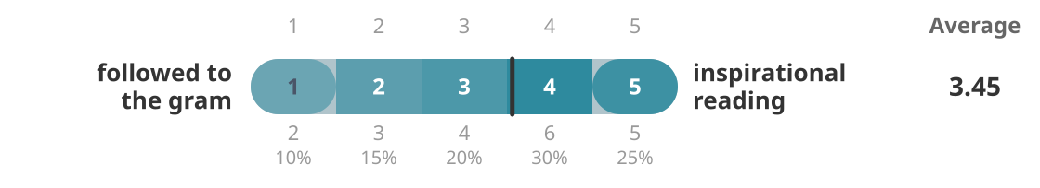
#2
Recipes:
20 responses

Slide 5
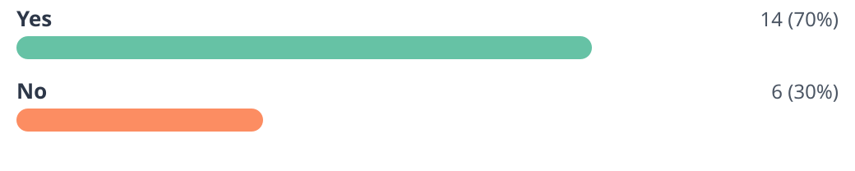
#3
Have you ever finished assembling furniture and had parts left over?
20 responses

Slide 6
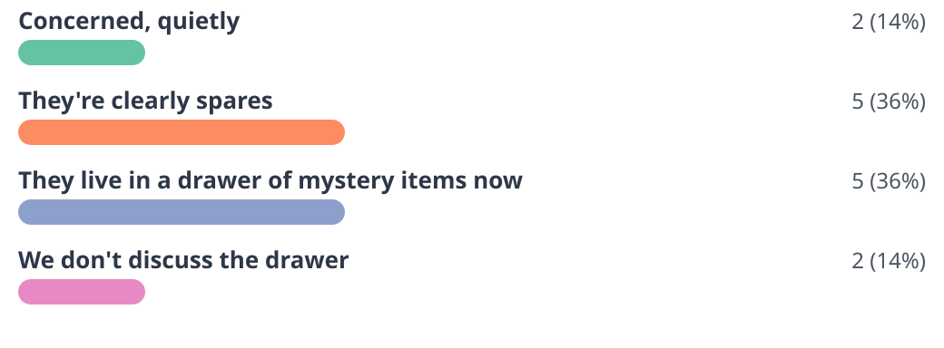
#4
And how do you feel about those parts?
14 responses

Slide 7
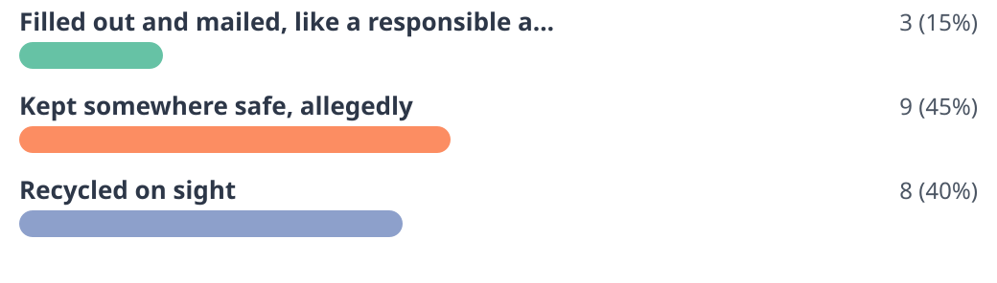
#5
Warranty cards:
20 responses

Slide 8
#6
What’s the best instruction you’ve ever ignored — and how did it go?
11 responses
• Read all instructions before beginning. I began. (1 person)
• Tighten every screw at the end. I tightened them at the start. The drawer closes at an angle now. (1 person)
• Rest the dough for an hour. We were hungry. The bread was fine. (1 person)
• Assemble on a soft surface. The floor has a scratch I now call character. (1 person)
• Let the paint dry overnight. It had a fingerprint by nine. (1 person)
• Two-person assembly. It took one person and one afternoon. (1 person)
• Wash before first use. It was a spatula. It was fine. (1 person)
• Do not stand on the top step. I did not. I thought about it a lot. (1 person)

Slide 9
#6
What’s the best instruction you’ve ever ignored — and how did it go?
• Keep your receipt. (1 person)
• None. I read them, and it went the way they said it would. (1 person)
• Charge fully before first use. I used it at forty percent and nothing bad happened. (1 person)

Slide 10
Thank You
Report generated from A short survey about whether you read instructions

